Slide 1
Model Thinking
Scott E Page

Slide 2
Six Sigma

Slide 3
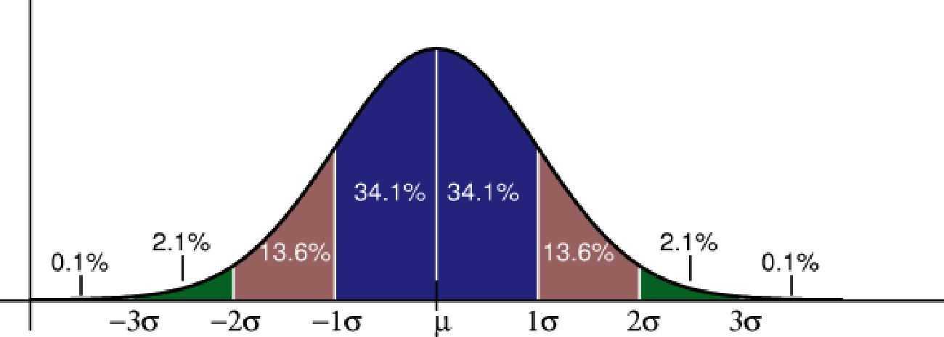

Slide 4
Average Banana Sales:
500 lbs
Standard Deviation:
10 lbs

Slide 5
Required Metal Thickness:
500-560 mm
Mean
530
Six Sigma Standard Deviation?

Slide 6
Model Thinking
Scott E Page

